Slide 1
Fundamentals of Design Analysis of Algorithms
ICAP 802
Introduction
Part-II

Slide 2
Chapter 1 Introduction
What is an Algorithm
Algorithm Specification
Performance Analysis
Randomized Algorithms.
Basic Data Structure:
Stacks and Queues, Trees, Dictionaries, Priority Queues, Sets and disjoint Set Union, Graphs.

Slide 3
Analysis of algorithm
Measuring Space complexity
Computing
best /worst/avg. case
.
Measuring Input size
Analysis of algorithms
Measuring Time complexity
Computing Order of growth
Measuring Running
(analyzing) time

Slide 4
Algorithmic Performance
two aspects of algorithmic performance:
Time
Instructions take time.
How fast does the algorithm perform?
What affects its runtime?
Space
Data structures take space
What kind of data structures can be used?
How does choice of data structure affect the runtime?
We will focus on time:
How to estimate the time required for an algorithm
How to reduce the time required

Slide 5
Analysis of Algorithms
Analysis of Algorithms is the area of computer science that provides tools to analyze the efficiency of different methods of solutions.
How do we compare the time efficiency of two algorithms that solve the same problem?
Naïve Approach: implement these algorithms in a programming language (like C++), and run them to compare their time requirements.

Slide 6
Time Efficiency
Comparing the programs (instead of algorithms) has some difficulties.
How are the algorithms coded?
Comparing running times means comparing the implementations.
We should not compare implementations, because they are sensitive to programming style that may cloud the issue of which algorithm is inherently more efficient.
What computer should we use?
We should compare the efficiency of the algorithms independently of a particular computer.
What data should the program use?
Any analysis must be independent of specific data.

Slide 7
Space complexity
The amount of memory required by an algorithm to run.
Two factors are required for computing Constant and instance
The space requirement S(p) is given as
S(p) = C + Sp
C is constant representing the space for
Inputs/outputs
Instructions
Variables
Identifiers
Sp is space dependent upon instance characteristics
It is variable part
Depends on particular problem instance

Slide 8
Time complexity
The amount of computer time taken by an algorithm to complete.
In multiuser system, execution time depends on
System load
No. other programs running
Instruction set used
Speed of hardware
So, time complexity is given in terms of frequency count(fc)
fc is a count denoting number of times of execution of statement

Slide 9
Measuring the running time
Running time: the time which is measured for analyzing an algorithm.
Basic operation: identify the important operation (logic) of an algorithm.
The operation which is more time consuming
Compute the total number of time taken by the basic operation (computing time)
Running time of basic operation : time taken by the basic operation * number of times the basic operation needs to be executed
T(n) ≈ c_{op} C(n)

Slide 10
Analysis of Algorithms
When we analyze algorithms, we should employ mathematical techniques that analyze algorithms independently of specific implementations, computers, or data.
To analyze algorithms:
First, we start to count the number of significant operations in a particular solution to assess its efficiency.
Then, we will express the efficiency of algorithms using growth functions.

Slide 11
General Rules for Estimation
Loops: The running time of a loop is at most the running time of the statements inside of that loop times the number of iterations.
Nested Loops: Running time of a nested loop containing a statement in the inner most loop is the running time of statement multiplied by the product of the sized of all loops.
Consecutive Statements: Just add the running times of those consecutive statements.
If/Else: Never more than the running time of the test plus the larger of running times of S1 and S2.

Slide 12
The Execution Time of Algorithms
Each operation in an algorithm (or a program) has a cost.
➔ Each operation takes a certain amount of time.
count = count + 1; ➔ take a certain amount of time, but it is constant
A sequence of operations:
count = count + 1; Cost: c₁
sum = sum + count; Cost: c₂
➔ Total Cost = c₁ + c₂

Slide 13
The Execution Time of Algorithms (cont.)
Example: Simple If-Statement
Cost Times
if (n < 0) c1 1
absval = -n c2 1
else
absval = n; c3 1
Total Cost <= c1 + max(c2,c3)

Slide 14
The Execution Time of Algorithms (cont.)
Example: Simple Loop
Cost Times
i = 1; c1 1
sum = 0; c2 1
while (i <= n) { c3 n+1
i = i + 1; c4 n
sum = sum + i; c5 n
}
Total Cost = c1 + c2 + (n+1)*c3 + n*c4 + n*c5
➔ The time required for this algorithm is proportional to n

Slide 15
The Execution Time of Algorithms (cont.)
Example: Nested Loop
Cost Times
i=1; c1 1
sum = 0; c2 1
while (i <= n) { c3 n+1
j=1; c4 n
while (j <= n) { c5 n*(n+1)
sum = sum + i; c6 n*n
j = j + 1; c7 n*n
}
i = i +1; c8 n
}
Total Cost = c1 + c2 + (n+1)*c3 + n*c4 + n*(n+1)*c5+n*n*c6+n*n*c7+n*c8
➔ The time required for this algorithm is proportional to n²

Slide 16
Exercise
Determine the frequency counts for all the statements in the following two codes?
for i = 1 to n do
for j = 1 to I do
for k = 1 to j do
x = x+1;
i =1
While (i<=n) do
{
x=x+1;
i=i+1;
}

Slide 17
Step table for an algorithm
Statement | Steps per Exe[s/e] | Frequency | Total Steps
Algorithm sum(a,n) | 0 | - | 0
{ | 0 | - | 0
s=0 | 1 | 1 | 1
for i=1 to n do | 1 | n+1 | n+1
s= s + a[i] | 1 | N | n
return s; | 1 | 1 | 1
} | 0 | - | 0
Total |  |  | 2n+3

Slide 18
Algorithm Growth Rates
We measure an algorithm’s time requirement as a function of the problem size.
Problem size depends on the application:
e.g. number of elements in a list for a sorting algorithm, the number disks for towers of hanoi.
for instance, we say that (if the problem size is n)
Algorithm A requires 5*n² time units to solve a problem of size n.
Algorithm B requires 7*n time units to solve a problem of size n.

Slide 19
Algorithm Growth Rates
The most important thing to learn is how quickly the algorithm’s time requirement grows as a function of the problem size.
Algorithm A requires time proportional to n².
Algorithm B requires time proportional to n.
An algorithm’s proportional time requirement is known as growth rate.
We can compare the efficiency of two algorithms by comparing their growth rates.

Slide 20
Common Growth Rates
Function | Growth Rate Name
c | Constant
log N | Logarithmic
log²N | Log-squared
N | Linear
N log N | Linear logarithmic
N² | Quadratic
N³ | Cubic
2^{N} | Exponential

Slide 21
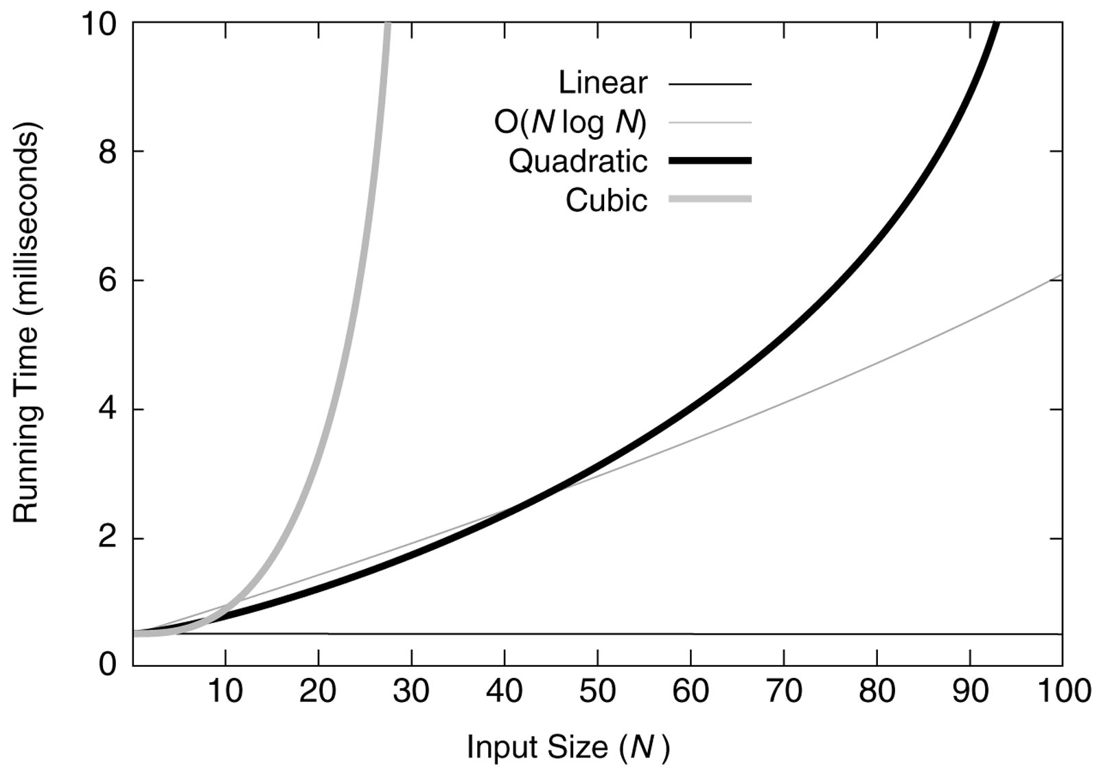
Running times for small inputs

Slide 22
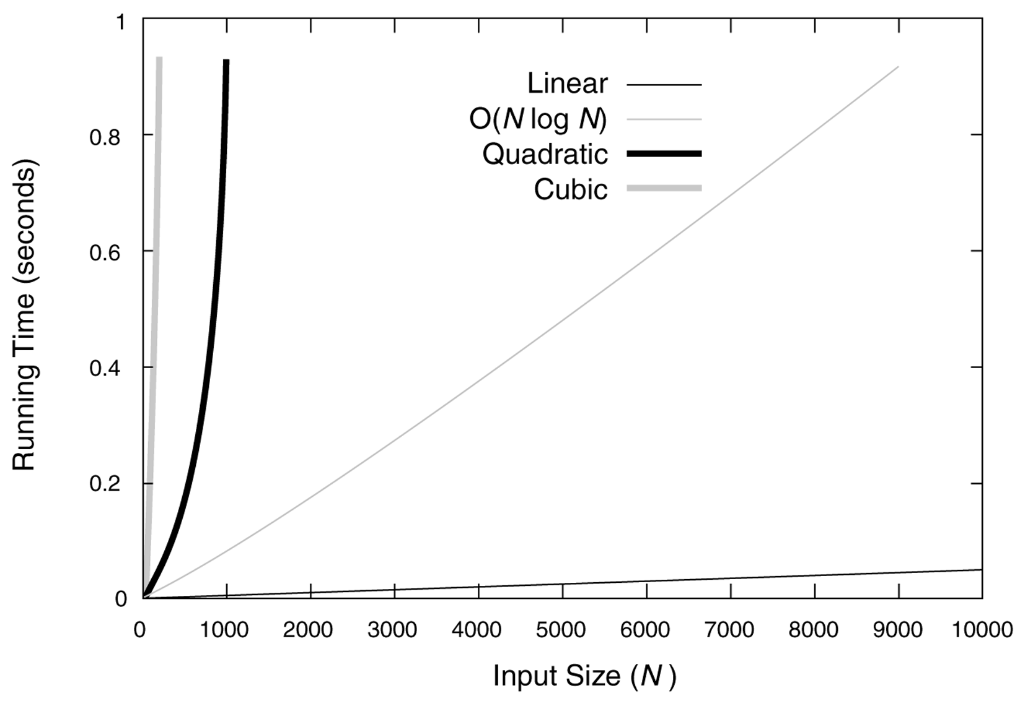
Running times for moderate inputs

Slide 23
Order-of-Magnitude Analysis and Big O Notation
If Algorithm A requires time proportional to f(n), Algorithm A is said to be order f(n), and it is denoted as O(f(n)).
The function f(n) is called the algorithm’s growth-rate function.
Since the capital O is used in the notation, this notation is called the Big O notation.
If Algorithm A requires time proportional to n², it is O(n²).
If Algorithm A requires time proportional to n, it is O(n).

Slide 24
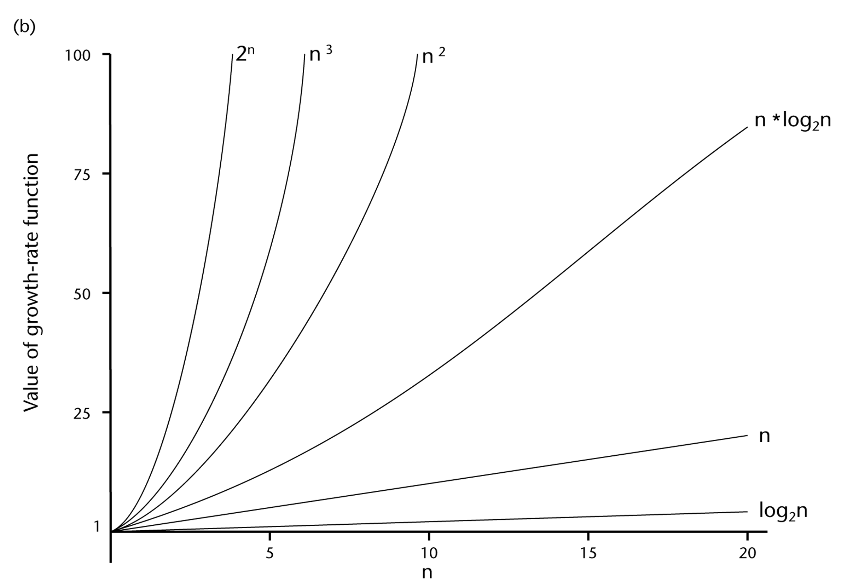
A Comparison of Growth-Rate Functions (cont.)

Slide 25
Growth-Rate Functions

Slide 26
Big oh Notation- O(1)
O(1) describes an algorithm that will always execute in the same time (or space) regardless of the size of the input data set.
Constant statement (one line of code) Example: a+=1;

Slide 27
Big oh Notation – O(n)
O(N) describes an algorithm whose performance will grow linearly and in direct proportion to the size of the input data set.
Big O notation will always assume the upper limit where the algorithm will perform the maximum number of iterations.
Linear Loop
Example: for(c=0; c<n; c++)
{ a+=1;
}

Slide 28
Big oh Notation – O(N² )
O(N²) represents an algorithm whose performance is directly proportional to the square of the size of the input data set.
This is common with algorithms that involve nested iterations over the data set.
Deeper nested iterations will result in O(N³), O(N⁴) etc.
Quadratic Double loop
Example: for(c=0; c<n; c++)
{ for(i=0; i<n; i++)
{ a+=1; }
}

Slide 29
Big oh Notation - O(2^{N})
O(2^{N}) denotes an algorithm whose growth will double with each additional element in the input data set.
The execution time of an O(2^{N}) function will quickly become very large.
Exponential Trying to break a password generating all possible combinations
Exhaustive search

Slide 30
Big oh Notation – O(log(n))
Logarithmic Divide in half (binary search)
while(n>1)
{
n=n/2;
}

Slide 31
Big oh Notation – O(nlog (n))
Linearithmic Mergesort, Quicksort, …
Effective sorting algorithms

Slide 32
Growth-Rate Functions- Example
If an algorithm takes 1 second to run with the problem size 8, what is the time requirement (approximately) for that algorithm with the problem size 16?
If its order is:
O(1) ➔ T(n) = 1 second
O(log₂n) ➔ T(n) = (1*log₂16) / log₂8 = 4/3 seconds
O(n) ➔ T(n) = (1*16) / 8 = 2 seconds
O(n*log₂n) ➔ T(n) = (1*16*log₂16) / 8*log₂8 = 8/3 seconds
O(n²) ➔ T(n) = (1*16²) / 8² = 4 seconds
O(n³) ➔ T(n) = (1*16³) / 8³ = 8 seconds
O(2^{n}) ➔ T(n) = (1*2¹⁶) / 2⁸ = 2⁸ seconds = 256 seconds

Slide 33
Properties of Growth-Rate Functions
We can ignore low-order terms in an algorithm’s growth-rate function.
If an algorithm is O(n³+4n²+3n), it is also O(n³).
We only use the higher-order term as algorithm’s growth-rate function.
We can ignore a multiplicative constant in the higher-order term of an algorithm’s growth-rate function.
If an algorithm is O(5n³), it is also O(n³).
O(f(n)) + O(g(n)) = O(f(n)+g(n))
We can combine growth-rate functions.
If an algorithm is O(n³) + O(4n), it is also O(n³ +4n²) ➔ So, it is O(n³).
Similar rules hold for multiplication.

Slide 34
Growth-Rate Functions – Example1
Cost Times
i = 1; c1 1
sum = 0; c2 1
while (i <= n) { c3 n+1
i = i + 1; c4 n
sum = sum + i; c5 n
}
T(n) = c1 + c2 + (n+1)*c3 + n*c4 + n*c5
= (c3+c4+c5)*n + (c1+c2+c3)
= a*n + b
➔ So, the growth-rate function for this algorithm is O(n)

Slide 35
Growth-Rate Functions – Example2
Cost Times
i=1; c1 1
sum = 0; c2 1
while (i <= n) { c3 n+1
j=1; c4 n
while (j <= n) { c5 n*(n+1)
sum = sum + i; c6 n*n
j = j + 1; c7 n*n
}
i = i +1; c8 n
}
T(n) = c1 + c2 + (n+1)*c3 + n*c4 + n*(n+1)*c5+n*n*c6+n*n*c7+n*c8
= (c5+c6+c7)*n² + (c3+c4+c5+c8)*n + (c1+c2+c3)
= a*n² + b*n + c
➔ So, the growth-rate function for this algorithm is O(n²)

Slide 36
Growth-Rate Functions – Example3
Cost Times
for (i=1; i<=n; i++) c1 n+1
for (j=1; j<=i; j++) c2
for (k=1; k<=j; k++) c3
x=x+1; c4
T(n) = c1*(n+1) + c2*( ) + c3* ( ) + c4*( )
= a*n³ + b*n² + c*n + d
➔ So, the growth-rate function for this algorithm is O(n³)

Slide 37

Asymptotic notations
Using asymptotic notations we can give time complexity as
fastest possible [best case]‚
slowest possible [worst case]‚
average time [ average case]
Big oh Notation (O) upper bound of alg. running time
Omega Notation (Ω) lower bound of alg. running time
Theta Notation ( ) between upper and lower bound of alg. running time
$$θ$$

Slide 38

Big oh notation [worst case]
Let f(n) and g(n) be two non-negative functions
Let n₀ and c are 2 integers (n> n₀), (c>0) then
f(n) <= c*g(n)
f(n) $∈$ O of g(n)
f(n) is less then g(n) if g(n) is multiple of some c

Slide 39

Omega Notation [best case]
Let f(n) and g(n) be two non-negative functions
Let n₀ and c are 2 integers (n>= n₀), (c>0) then
f(n) >= c*g(n)
f(n) $∈$ Ω g(n)
f(n) is greater then or equal to g(n) if g(n) is multiple of some c

Slide 40


Theta notation [avg. case]
Let f(n) and g(n) be two non-negative functions
Let c1 and c2 are 2 positive constants such that
C₂g(n) <= f(n) <= c₁g(n)
f(n) $∈$ g(n)
The running time is between upper and lower bonds
$$θ$$

Slide 41
.
Examples

Slide 42
Linear Search
Linear search or Sequential search is a method for finding a particular value in a list that checks each element in sequence until the desired element is found or the list is exhausted.
The list need not be ordered.

Slide 43
Sequential search algorithm
Given: List of numbers: A₁, A₂, A₃, …., A_{n} and a query number x;
Question: Search for x in the list;
Sequential-Search(A, n, x);
(* Search for x in A1, A2,…, An. *)
begin
for k ← 1 to n do
if (x = A[k])
then (Print “Yes”; Stop)
else (* do nothing *)
endfor
Print “No”; Stop
end;

Slide 44
Sequential Search
int sequentialSearch(const int a[], int item, int n){
for (int i = 0; i < n && a[i]!= item; i++);
if (i == n)
return –1;
return i;
}
Unsuccessful Search: ➔ O(n)
Successful Search:
Best-Case: item is in the first location of the array ➔O(1)
Worst-Case: item is in the last location of the array ➔O(n)
Average-Case: The number of key comparisons 1, 2, ..., n
➔ O(n)

Slide 45
Binary search
a binary search or half-interval search algorithm finds the position of a target value within a sorted array.
Binary search works by comparing an input value to the middle element of the array.
The comparison determines whether the element equals the input, less than the input or greater.

Slide 46
Binary Search
int binarySearch(int a[], int size, int x) {
int low =0;
int high = size –1;
int mid; // mid will be the index of
// target when it’s found.
while (low <= high) {
mid = (low + high)/2;
if (a[mid] < x)
low = mid + 1;
else if (a[mid] > x)
high = mid – 1;
else
return mid;
}
return –1;
}

Slide 47
Binary Search – Analysis
For an unsuccessful search:
The number of iterations in the loop is ⎣log₂n⎦ + 1
➔ O(log₂n)
For a successful search:
Best-Case:
The number of iterations is 1. ➔ O(1)
Worst-Case:
The number of iterations is ⎣log₂n⎦ +1 ➔ O(log₂n)
Average-Case:
The avg. # of iterations < log₂n ➔ O(log₂n)

Slide 48
How much better is O(log₂n)?
n O(log₂n)
16 4
64 6
256 8
1024 (1KB) 10
16,384 14
131,072 17
262,144 18
524,288 19
1,048,576 (1MB) 20
1,073,741,824 (1GB) 30

Slide 49
Binary Search (How fast is it?)
Imagine n=100
After 1 step, size is ≤ 50
After 2 steps, size is ≤ 25
After 3 steps, size is ≤ 12
After 4 steps, size is ≤ 6
After 5 steps, size is ≤ 3
After 6 steps, size is ≤ 1
DONE!!
What if n=1000? 1,000,000?

Slide 50
Time Complexity Analysis
Sequential Search (Algorithm):
Worst Case: n comparisons
Best Case: 1 comparison
Avg Case: n/2 comparisons
Binary Search (Algorithm):
Worst Case: log₂ n comparisons
Best Case: 1 comparison
Avg Case: about log₂ n comparisons
How to get the Average Case?
using mathematical analysis…

Slide 51
Logarithm basics
log 2^{x} = y means x = 2 ^{y}
log₂ x tells you how many bits are needed to hold x values
8 bits holds 256 numbers: 0 to 2⁸ -1 = 0 to 255
log₂ 256 = 8
log X grows slower than X
log log X grows very slowly (but it grows!)

Slide 52

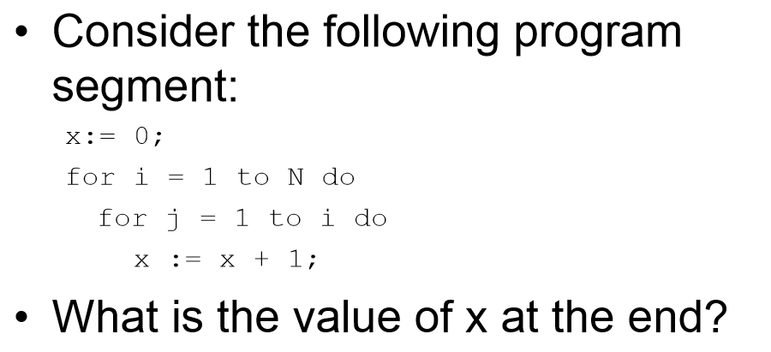
Arithmetic Series

Slide 53
.
Total number of times x is incremented is the number of “instructions” executed
Running time of the program is proportional to N(N+1)/2 for all N = O(n²)

Slide 54
Growth Rate | Name | Code e.g. | Description
1 | Constant | a+=1; | statement (one line of code)
log(n) | Logarithmic | while(n>1){ n=n/2;} | Divide in half (binary search)
n | Linear | for(c=0; c<n; c++){ a+=1;} | Loop
n*log(n) | Linearithmic | Mergesort, Quicksort, … | Effective sorting algorithms
n^2 | Quadratic | for(c=0; c<n; c++){ for(i=0; i<n; i++){ a+=1; }} | Double loop
n^3 | Cubic | for(c=0; c<n; c++){ for(i=0; i<n; i++){ for(x=0; x<n; x++){ a+=1; } }} | Triple loop
2^n | Exponential | Trying to braeak a password generating all possible combinations | Exhaustive search

Slide 55
Exercise
Consider the following algorithm Add and obtain run times for n = 1,50 and 100
algorithm Add(a,b,c,m,n)
{
for i = 1 to m do
for j = 1 to n do
c[i,j] = a[i,j] + b[i,j]
}

Slide 56
Exercise
An algorithm searches an unsorted array for the element x. if x occurs o/p the position in the array else returns zero.
Algorithm for factorial of a number both in recursive and iterative.

